Slide 1
Mobile Forensics
Lecture 1
Apple File System (APFS)
Fall 2022

Slide 2
Introduction
Apple developed the APFS
— pre-release in 2016
— The main architect was Dominic Giampaolo [33]. Hansen and Toolan
— Educational and development purpose in MacOS v 10.12 (Sierra) in Sept
— APFS was deployed on iPhone and iPad in March 2017
— the APFS uses encryption on the user data partition of an iPhone and that users can not disable the encryption

Slide 3
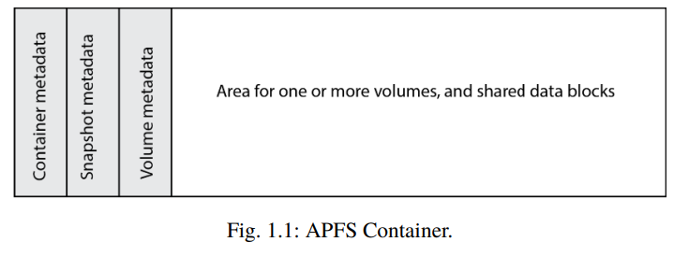
APFS - File system category
New feature for APFS is how it structures volumes
— it uses storage or a partition to set up a container
— This container will contain both container metadata, metadata for
snapshots and volumes, and data blocks

Slide 4
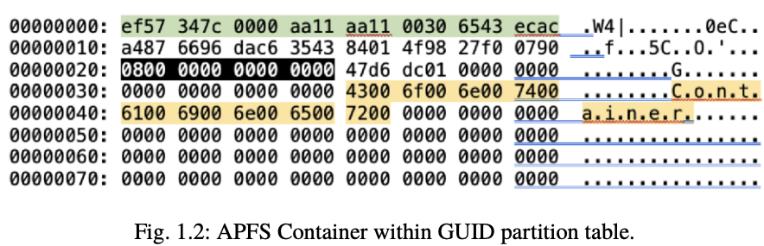
Finding the APFS container
Learning how to read GUID partition table

Slide 5
The field with black background is the eight bytes describing the start sector of this APFS container, and since this is a multi-byte field, it must be read as LE, meaning 0x8 (8 in decimal).
The first four bytes need to be read as little-endian (LE), and therefore ef57347c is read from right to left (backwards) as 7c3457ef
The field with black background is the eight bytes describing the start sector of this APFS container, and since this is a multi-byte field, it must be read as LE, meaning 0x8 (8 in decimal).

Slide 6
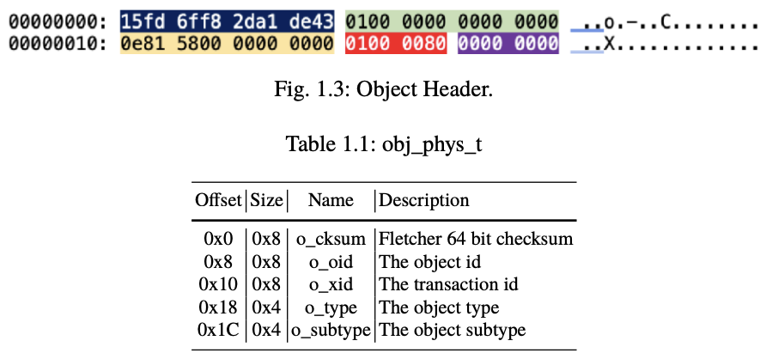
Object Header
Every object in APFS has an object header

Slide 7
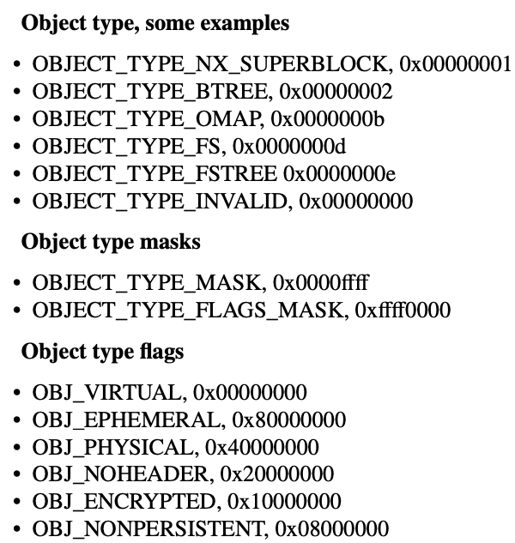

Slide 8
The object type is 80000001 (highlighted in red), and after computing the object type and flags, we found that the object type value is 0x00000001, and the object type flags is 0x80000000 (OBJ_EPHEMERAL).

Slide 9
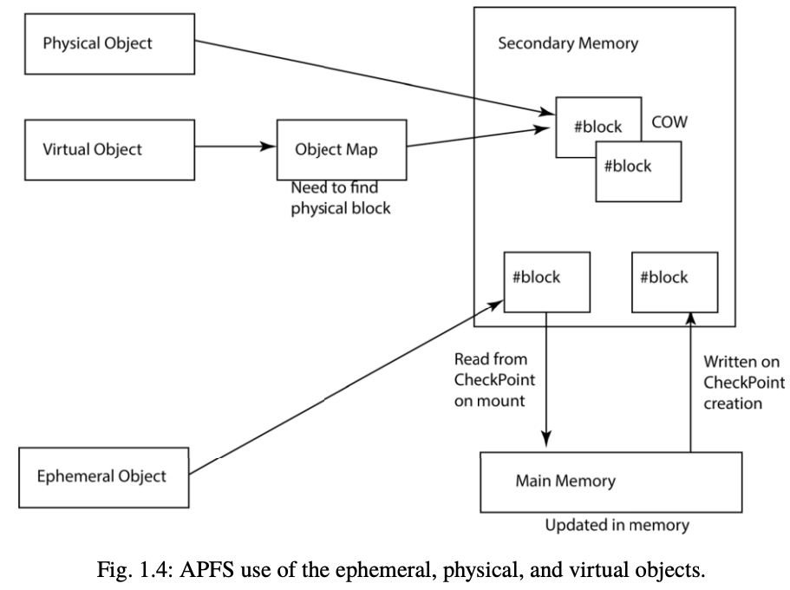

Slide 10
Ephemeral Objects
Objects should be in memory (ephemeral)
Objects are changed in memory when needed
Objects will be written to disk as a part of a checkpoint

Slide 11
Physical Objects
Objects that are stored in a known block address
Objects change needs to be written to another location because of the Copy-On-Write (COW) feature
The object id is the 8 Rune Nordvik same as the block address, and therefore any change means saving to a new block address, this also means a new object id.

Slide 12
Virtual Objects
Virtual objects stored at a block address
can be found by looking up in a object map (often a B-Tree)
The object id is the same after updating a virtual object
When a virtual object changes, it will be written to another physical block (COW), but the virtual object id is still the same in the object header o_oid field.

Slide 13
Superblocks
APFS uses different kinds of superblocks
Container Superblock (CSB): a nx_superblock_t structure
Addresses that point to locations on the disk are in 64bits, meaning eight bytes
These addresses point to ephemeral, physical or virtual objects

Slide 14
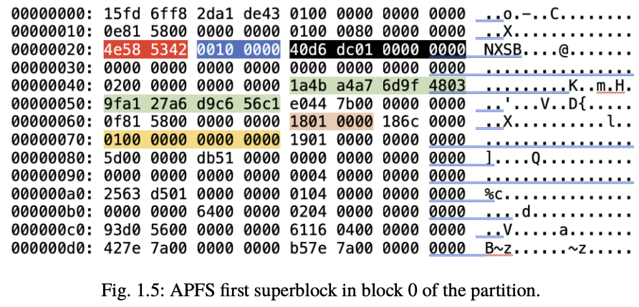

Slide 15

Magic key NXSB (0x4e585342): superblock
Next field (4 bytes) with blue background is the block size used, here 0x1000 (4096) bytes
Black background, we have an 8-byte field describing how many blocks this container contains, here 0x1dcd640 (31249984)

Slide 16
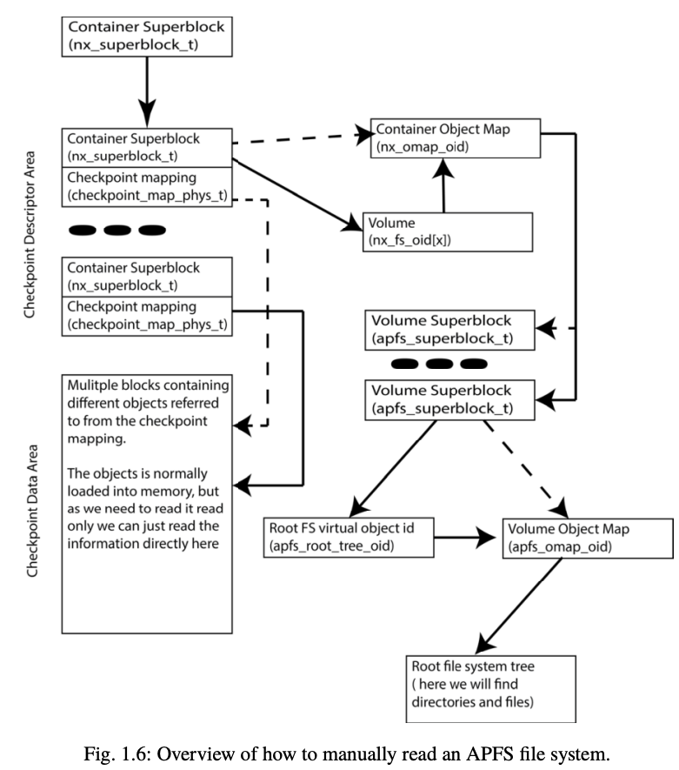
In light green background we can see the GUID, which uniquely identifies this container.
It has the value A7A44B1A-9F6D-0348-9FA1-27A6D9C656C1.

Slide 17
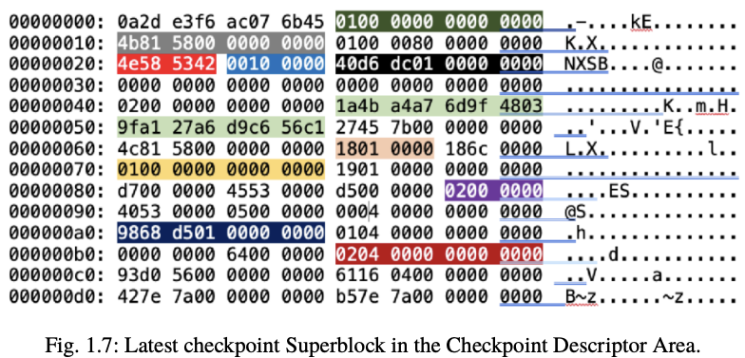

Slide 18
Two other requirements must be fulfilled
• The NXSB magic must be found.
• The checksum must verify, or else there is something wrong with the checkpoint superblock.

Slide 19
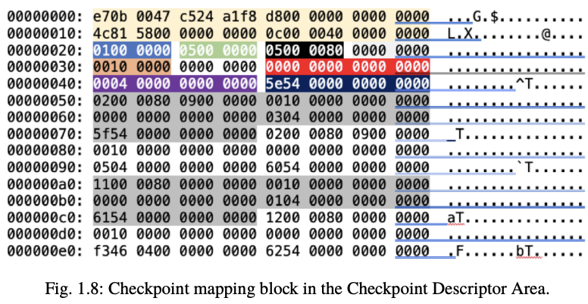
Checkpoint mapping

Slide 20
The 0x20 (32) bytes highlighted in yellow is the usual object header, but here the field is called cpm_o, and cpm is an abbreviation for checkpoint mapping
The last mapping block is always marked as the last, using the cpm_flags field, highlighted in blue. In this case, it is 0x01, since we only have one such mapping block
0x5 records in an array (highlighted in green)

Slide 21
Volumes
The maximum number of possible volumes are defined in field nx_max_file_systems found in the checkpoint superblock
– 0x64 (100)
From offset 0xB8 we find an array of fs volume virtual object ids, of which the first has the value 0x402
In order to identify the location of the volume boot record (VBR) for a file system
— map the virtual object id with the one found in the Container Object Map,
where we can find the block, which is the address to the VBR。

Slide 22
The Container Object Map object id：
— checkpoint superblock at byte offset 0xA0 (nx_omap_oid)
— a 64-bit value, here 0x1D56898 (30763160)
B-Tree

Slide 23
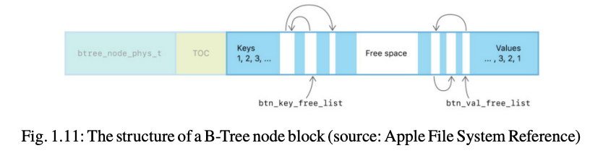
B-Tree

Slide 24
The first part of the block contains the btree_node_phys_t structure
Both include the object header (0x20 in size) and the node header (0x18 in size)
The data area is everything after the headers
This data area contains the table of content (TOC), keys, free space and the values.

Slide 25
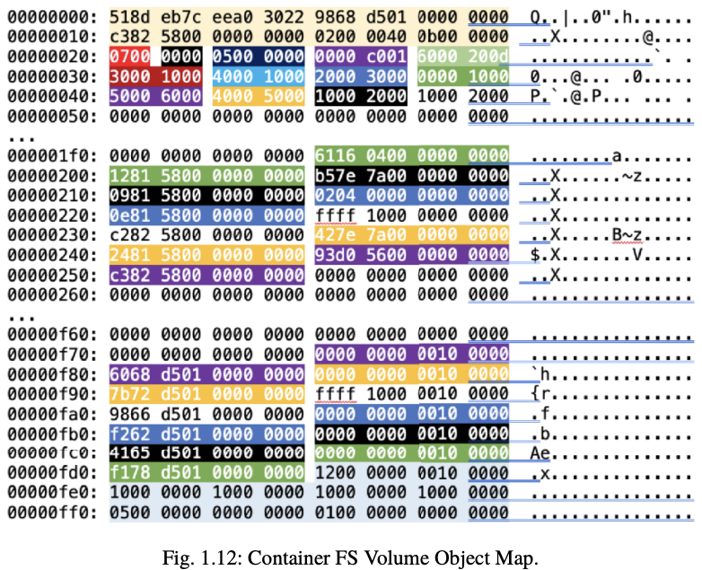

Slide 26
From the B-tree object header in Figure 1.12 we can see that the o_type describe a physical (0x40000000) B-tree (0x2)
The o_subtype is a object map (0xb)

Slide 27
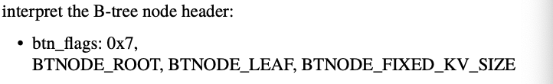
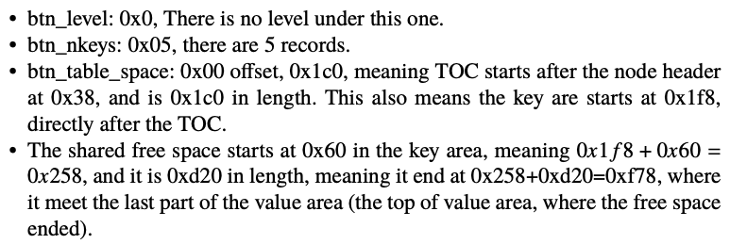
Interpret the B-Tree node header

Slide 28
From the TOC, we can find the key-value pairs
—If BTNODE_FIXED_KV_SIZE flag is set, only offsets to keys and values are used.
— If not, both offset and length are used.
Interpret the key-value offsets in the TOC in a special way
— static length (the BTNODE_FIXED_KV_SIZE flag was set), the key and value are represented as 16-bit offsets
When we read the offset for the key, we need to consider that the offset is relative to the start of the key area
The last structure of the B-tree Root node is the btree_info_t （Table 1.9)

Slide 29
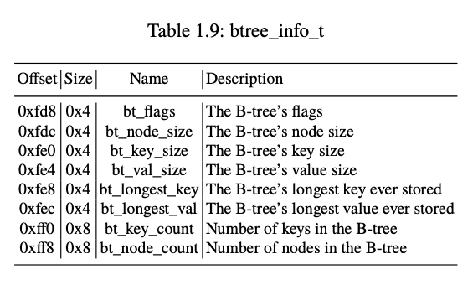

Slide 30
Finding the Volume
The first record key-pair is highlighted in blue from offset 0x38, the first 16 bits key value 0x20 points to the key, while the second 16 bits value 0x30 points to the value
The key can be found counting 0x20 from the start of the key area, and it is also in this case 0x10 in size.
The key is also highlighted in blue.
It is important to read the keys and values as 0x10 (16 bytes) each, as described in the btree_info_t structure.
Fig 1.13

Slide 31
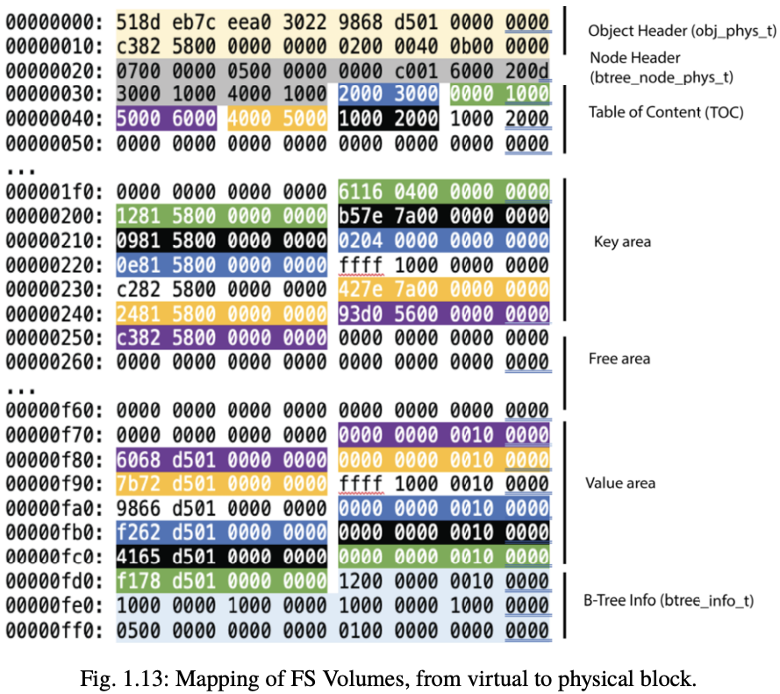

Slide 32
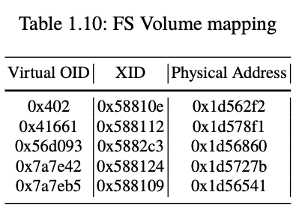

Slide 33
Showing the Volume (APSB)
A volume in APFS uses the magic key APSB
Superblock
Similar to a VBR in traditional file systems
It contains an FS, files, metadata, and object map.The magic of this apfs volume superblock has the signature APSB is ASCII values, found int the apfs_magic field.
This value can be used when searching for APFS volumes in a corrupted file system

Slide 34
Time
Apfs_unmount_time
must be interpreted as nanoseconds since January 1, 1970 at 0:00 UTC, not including leap seconds
converted to decimal and divided with 109 to get the value as seconds
used a UNIX epoch converter to translate it to a human-readable time format

Slide 35
timestamp in the APFS
timestamp in the APFS volume superblock, in the field 0x100 (apfs_last_mod_time)
64 bit value 0x0x15E3C994B2AF9600, or Thursday, 26 December 2019 02:05:35
when the volume was last modified, modifying the metadata does not update this timestamp

Slide 36
encryption purposes
encryption in the field apfs_meta_crypto
check in the apfs_fs_flags to see if the fs utilise encryption
apfs_root_tree_type describes the type of tree
field apfs_extentref_tree_type, which is described as a physical B-tree
next field is the apfs_snap_meta_tree_type, and it is also described as a physical B-Tree

Slide 37
need an object map
need to map virtual object ids to physical object ids
find the object map object identifier in the apfs_omap_oid
virtual object id for the root tree can be found in the field apfs_root_tree_oid
since this is a virtual object id, we need to map it to the physical object id using the apfs_omap_oid

Slide 38
apfs_num_files describes the number of files in the volume
e 0x245e6 (148966) files
We can find the number of directories in the field apfs_num_directories, here 0x10ef9 (69369) directories
This volume contains 1 snapshot, described in the field apfs_num_snapshots.
The apfs_vol_uuid is a unique identifier for this volume, in this case it is EC639B93-C4D6-4639-8910-5E6839BF0530
At offset 0x108, we find the volume Flags (apfs_fs_flags), and here it is 0x01, meaning this volume is not encrypted

Slide 39
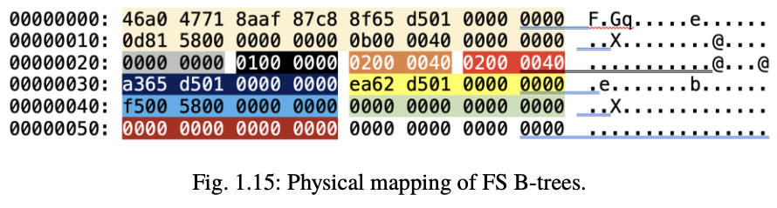
Volume Object mapping

Slide 40
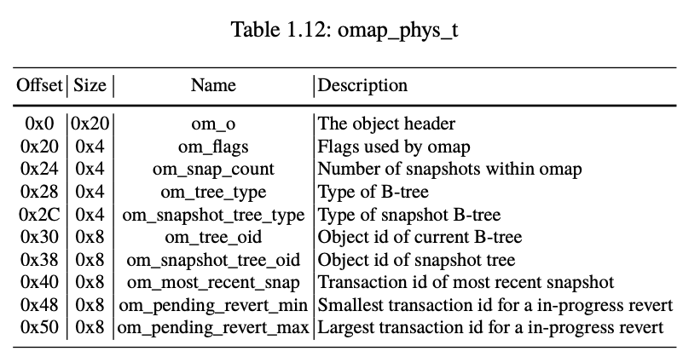

Slide 41
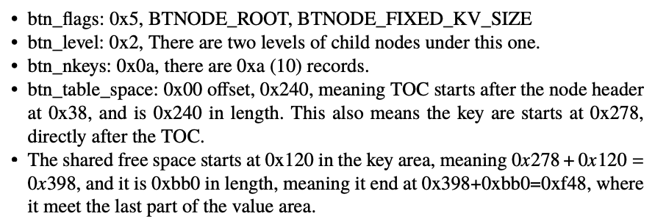
node header

Slide 42
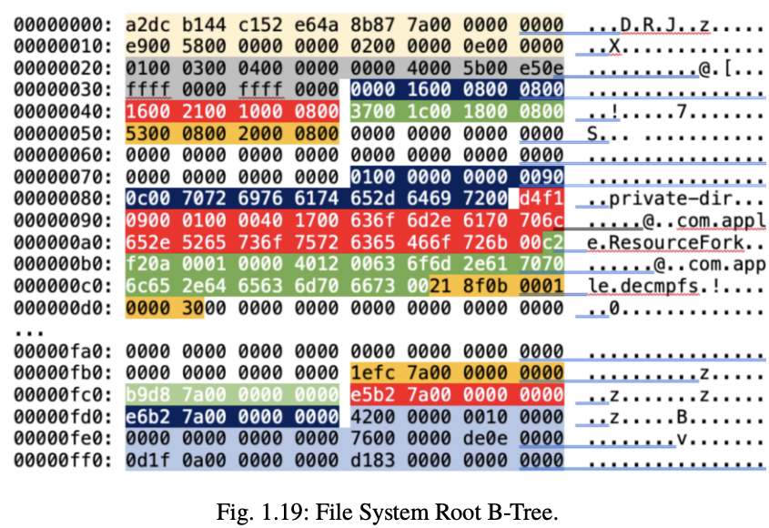
APFS - Metadata Category

Slide 43
APFS - Metadata Category
the content of the physical object id block 0x1d66e7f, and this block has the virtual object id 0x7a878b, found in byte 8 in the object header
typical for a virtual object id when read it from its physical address
virtual object id will still be stored from byte 8 in the object header

Slide 44
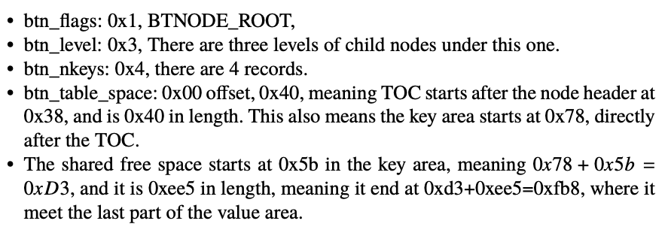

Slide 45

four entries in this block using different background colors.
OBJ_ID_MASK (0x0fffffffffffffff)
OBJ_TYPE_MASK (0xf000000000000000)
OBJ_TYPE_SHIFT (60)

Slide 46
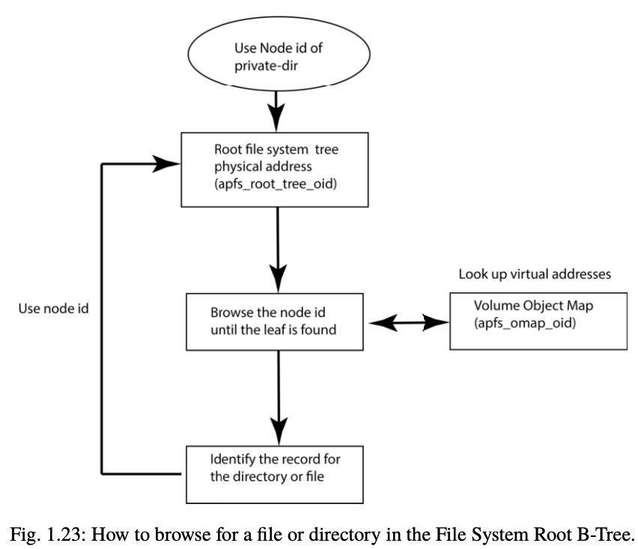
APFS - File Name category

